Slide 1
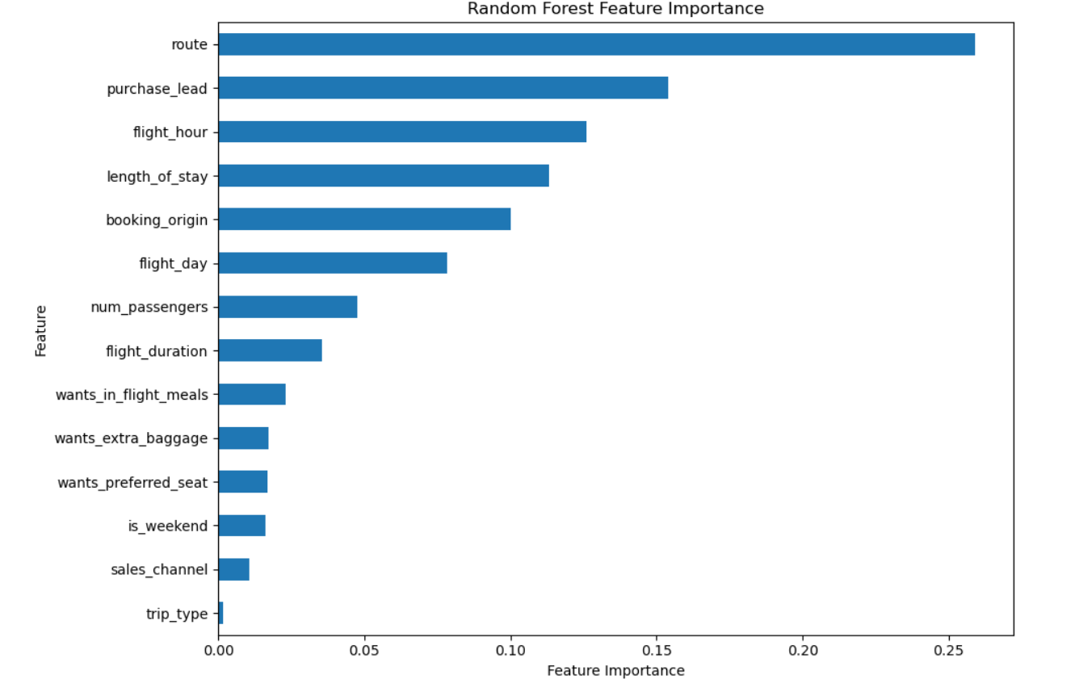

Predicting Customer Buying Behaviour
BUSINESS OBJECTIVE
Predict whether a customer is likely to complete a booking, enabling British Airways to proactively target high-potential customers before travel.
Dataset: 50,000 customer bookings
Target: booking_complete
MODEL PERFORMANCE
ROC-AUC: 0.790
5-Fold CV ROC-AUC: 0.776 ± 0.004
The model shows reasonable ability to distinguish customers who complete bookings from those who do not, with consistent cross-validation performance.
Route contributes the most to model prediction (25.9% feature importance).
Purchase lead, flight hour and length of stay are the next strongest predictors.
The model identifies meaningful patterns, but performance is moderate (CV ROC-AUC 0.776)
Prioritise customers associated with high-performing routes.
Use booking timing and travel characteristics to identify potential customers earlier.
Use model predictions for targeted marketing, rather than treating every customer equally.
.

